Slide 1
Scholarship 101
Ms. Meyer

Slide 2
When to complete?
FAFSA
Scholarships

Slide 3
TYPES OF SCHOLARSHIPS
INSTITUTIONAL
LOCAL
NATIONAL
MAJOR/SPECIFIC

Slide 4
Institutional

Slide 5
Institutional Aid
Institutional awards have higher dollar amounts and are almost always renewable!
Check with the schools that you are applying for!
Is there a separate application?
What are the deadlines!?

Slide 6
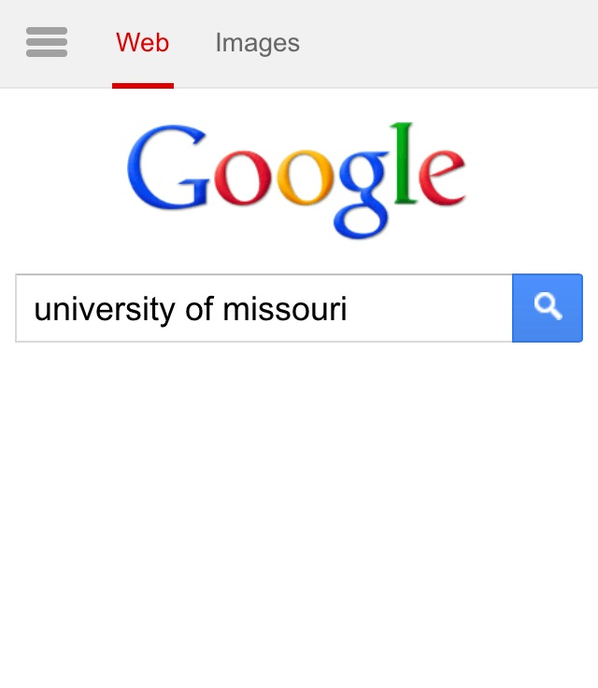
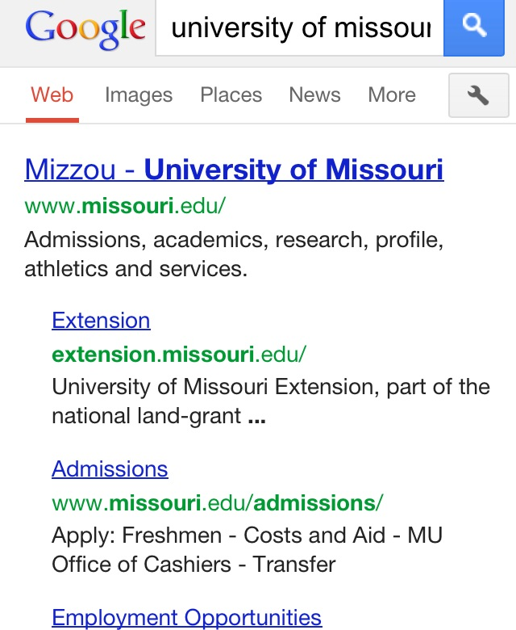
How to find Institutional Scholarships

Slide 7
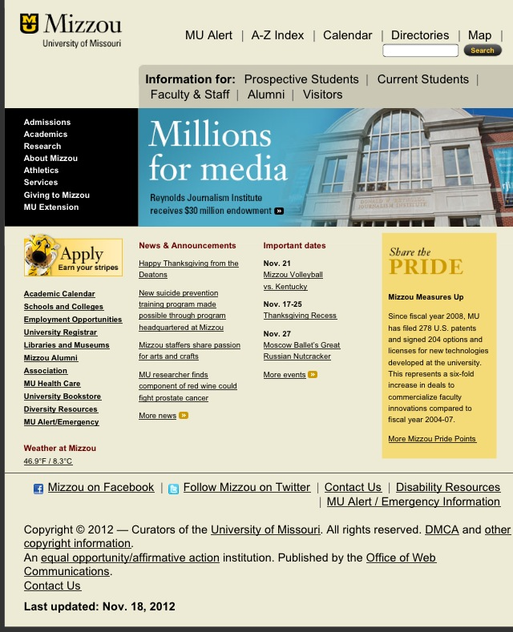
Look for Admissions or Financial Aid/Cost

Slide 8
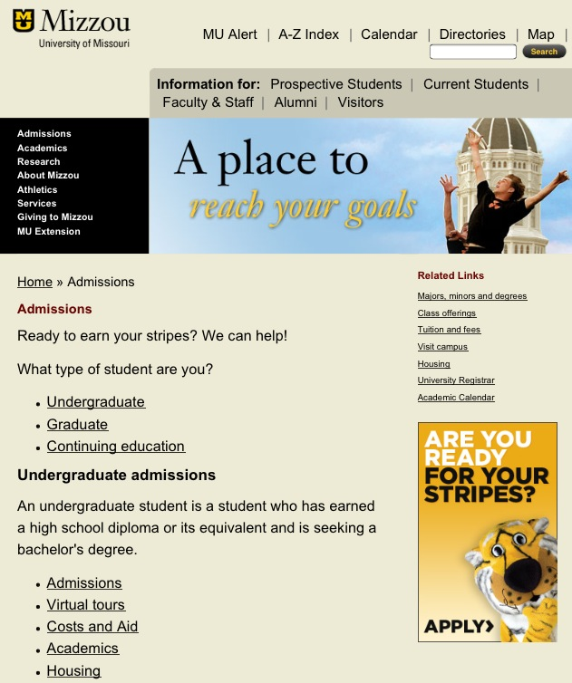
Find Costs or Financial Aid

Slide 10
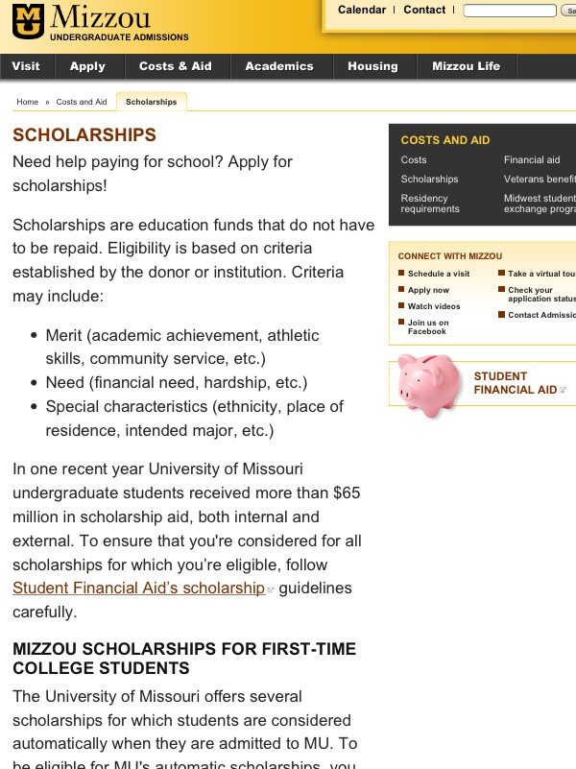

Slide 11
A+ Program is Not Only for Community College!
Avila University: $1000; up to 4 years
Central Methodist: 1/2 off tuition; up to 4 years
Columbia College: up to $2500; up to 4 years
Culver Stockton: $1500; one year
Hannibal-LaGrange: $3000; up to 4 years
Missouri Southern State University:$1000; up to 4 years
Missouri State University: $500; up to 4 years
Missouri Valley College: 1/2 off tuition; up to 4 years
Missouri Western State University: $1500; up to 4 years
Northwest Missouri State University: $1500; up to 2 years
Park University: $3000; up to 4 years
Stephens College: $1000; up to 4 years
Truman State University: $500; up to 4 years
William Jewell College: $1000; transfer student only
William Woods University: $1000; up to 4 years
**Other requirements may apply. Check each school’s website for more details**

Slide 12
Local Scholarships
From the local Independence/ Kansas City Community.
They can be sponsored by clubs, associations, or organizations
Smaller competition to receive the scholarship

Slide 13
Local Scholarships
Applications and Deadlines are not typically until January-April
Some examples of local scholarships:
ISD FOUNDATIONS
TRUMAN HEARTLAND

Slide 14
National
These usually have larger award amounts but you are competing with students from all over the nation.
They are sometimes sponsored by large companies and although they are good to apply for, they usually do not lead to being a large source of scholarships for students, local and institutional scholarships reap more benefits.
Deadlines range and can be all year

Slide 15
National Scholarship Resources
http://www.fastweb.com/
https://studentaid.ed.gov/types/grants-scholarships/finding-scholarships
http://www.zinch.com/
http://www.schoolsoup.com/
Most will require you to make a profile!

Slide 16
Major/Specific
These refer to scholarships offered for students who want to go into a certain profession. Many foundations associated with certain careers offer aid for these students.
Specific refers to aid offered based on your demographics. These usually have a certain set of criteria and are good because they narrow down the applicant pool.
Deadlines range and can be all year

Slide 17
Questions to ask about all scholarships?
Is it renewable?
Is it portable? (Can you take it from one school to another if you decide to transfer?)

Slide 18
NEVER, EVER,
EVER
PAY FOR A SCHOLARSHIP
SEARCH!

Slide 19
Let’s get started!
Start your scholarship search early!
Make sure you are reading the eligibility requirements carefully!
Put together a scholarship portfolio:
-Resume (Templates on Word)
-Letters of Recommendation (From Teachers?)
-College Essay

Slide 20
Scholarship Essays
Almost all essays have similar prompts, get started early by brainstorming ideas about essays:
-Leadership experiences
-Long term/short term goals
-Personal statements
-Community service
Proofread
-Have someone else read your essays
(peers, teachers, college adviser)

Slide 21
Example of Essay Questions:
Discuss the subjects in which you excel or have excelled. To what factors do you attribute your success?
Discuss a leadership experience you have had in any area of your life: school, work, athletics, family, church, community, etc. How and why did you become a leader in this area? How did this experience influence your goals?
Discuss your involvement in and contributions to a community near your home, school or elsewhere.
HINT: These are directly from the Gates Millennium Scholarship

Slide 22
Some Scholarships Deadlines for October:
Horatio Alger Missouri Scholarship Program
Eligibility: Missouri residents only; extra-curricular/ community involvement; minimum of 2.0 GPA
Award: Ten $6,000
Deadline: Oct. 25
https://www.horatioalger.org/scholarships/program_missouri.cfm
Omega Psi Phi, Inc.
Eligibility: Open to all college-bound, high school seniors, essay
Award: Up to $3,000
Deadline: Oct. 25
http://www.omegapsiphifraternity.org/essay-contest.asp

Slide 23
Free Application for Federal Student Aid
Any websites you use should end in .gov (watch out for scams!)
You should NEVER have to pay to fill out the FAFSA
The FAFSA is not a type of loan or grant, it is the application to receive loans or grants
The priority deadline for the FAFSA is March 1st because at that point the money is divided up, BUT if for some reason you have to wait till past March 1st you should still apply because money for grants MAY be left over
www.fafsa.ed.gov

Slide 24
Resources
Follow @Falcons2College
Check out Van Horn’s College Center website for different scholarship links including this presentation!

